Slide 1
Morphing
CSE 590 Computational Photography
Tamara Berg

Slide 2
Announcements
HW3 online after class
Submit facial point locations by Sunday night (March 17)
Final due date for HW extended to April 1

Slide 3
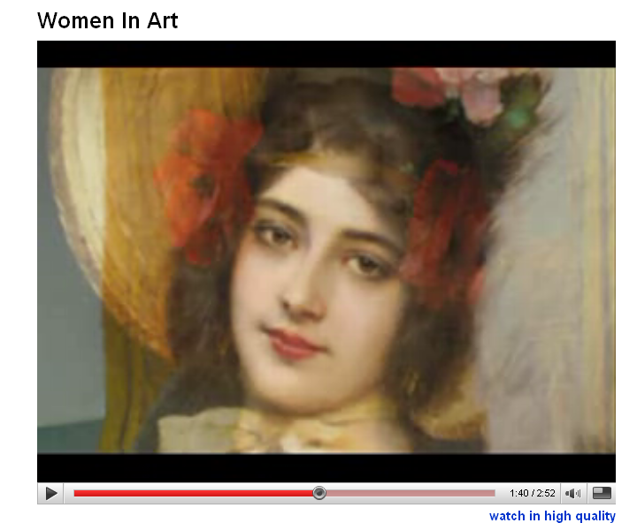
Image Morphing - Women in Art video
http://youtube.com/watch?v=nUDIoN-_Hxs
Notes:
Another related idea is image morphing.

Slide 4
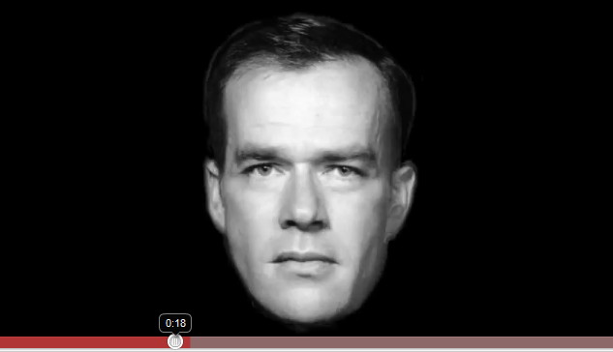
Morphing
http://www.youtube.com/watch?v=L0GKp-uvjO0

Slide 5
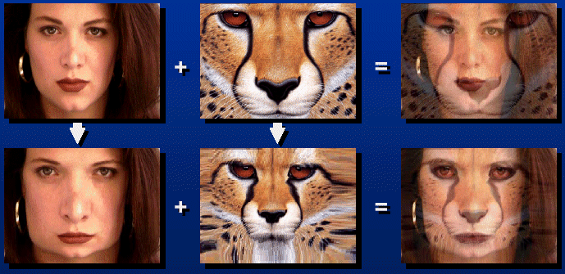

Morphing = Object Averaging
The aim is to find “an average” between two objects
Not an average of two images of objects…
…but an image of the average object!
How can we make a smooth transition in time?
Do a “weighted average” over time t
How do we know what the average object looks like?
We haven’t a clue!
But we can often fake something reasonable
Usually required user/artist input
Notes:
Here you want to find an average between two objects.
Not the average image, but the average object (something that looks like an average between the object on the left and the object on the right).
How could we smoothly transition between one object and another? We can do a sort of weighted average over time.
But what does the average object look like? Well we really haven’t a clue, but we can often fake something reasonable.

Slide 6
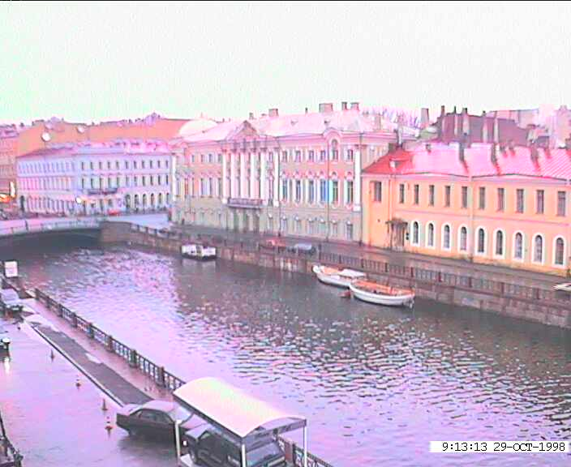
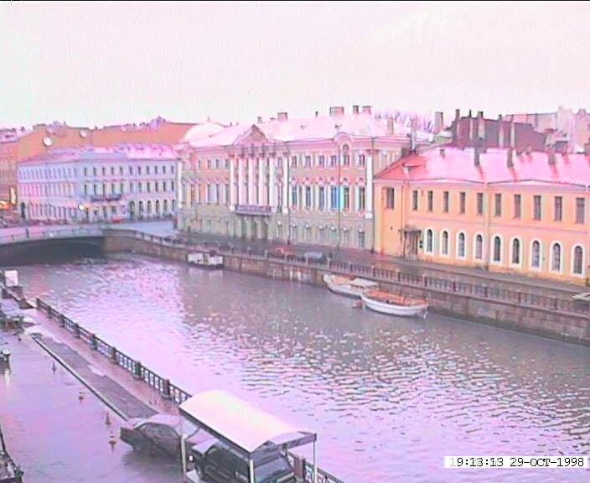
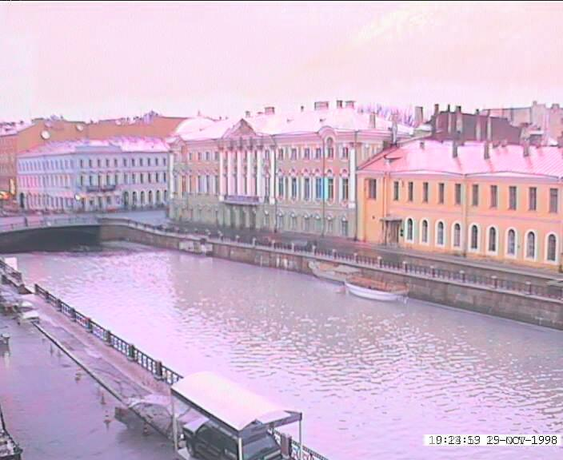
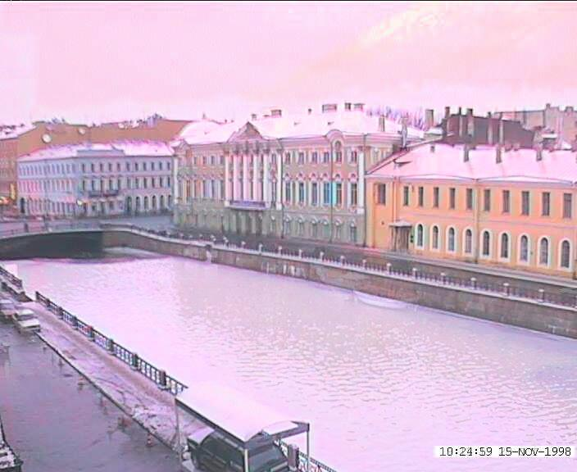
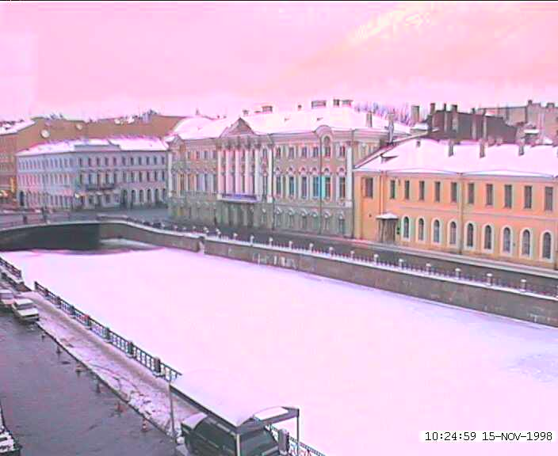
Idea #1: Cross-Dissolve
Interpolate whole images:
Image_{halfway} = (1-t)*Image₁ + t*image₂
This is called cross-dissolve in film industry
But what if the images aren’t aligned?
Notes:
How might we take an average between two things?
Well how about this. Let’s interpolate the whole image so at time 0 we use image 1 and at time t we use image 2 and in between we use (1-t) times image 1 and t*image 2.
This is called a cross-dissolve. And that works pretty well for these images.

Slide 7
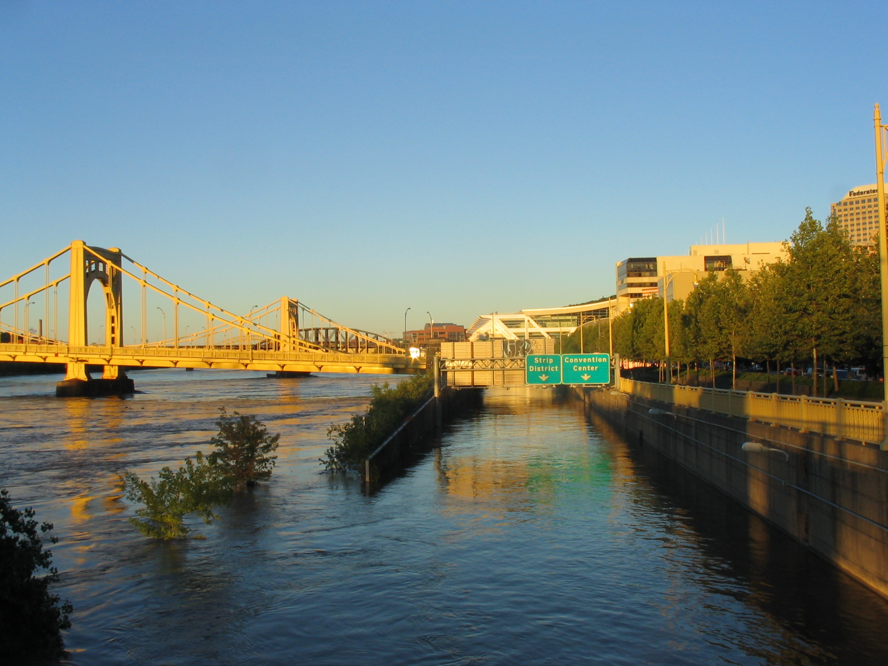
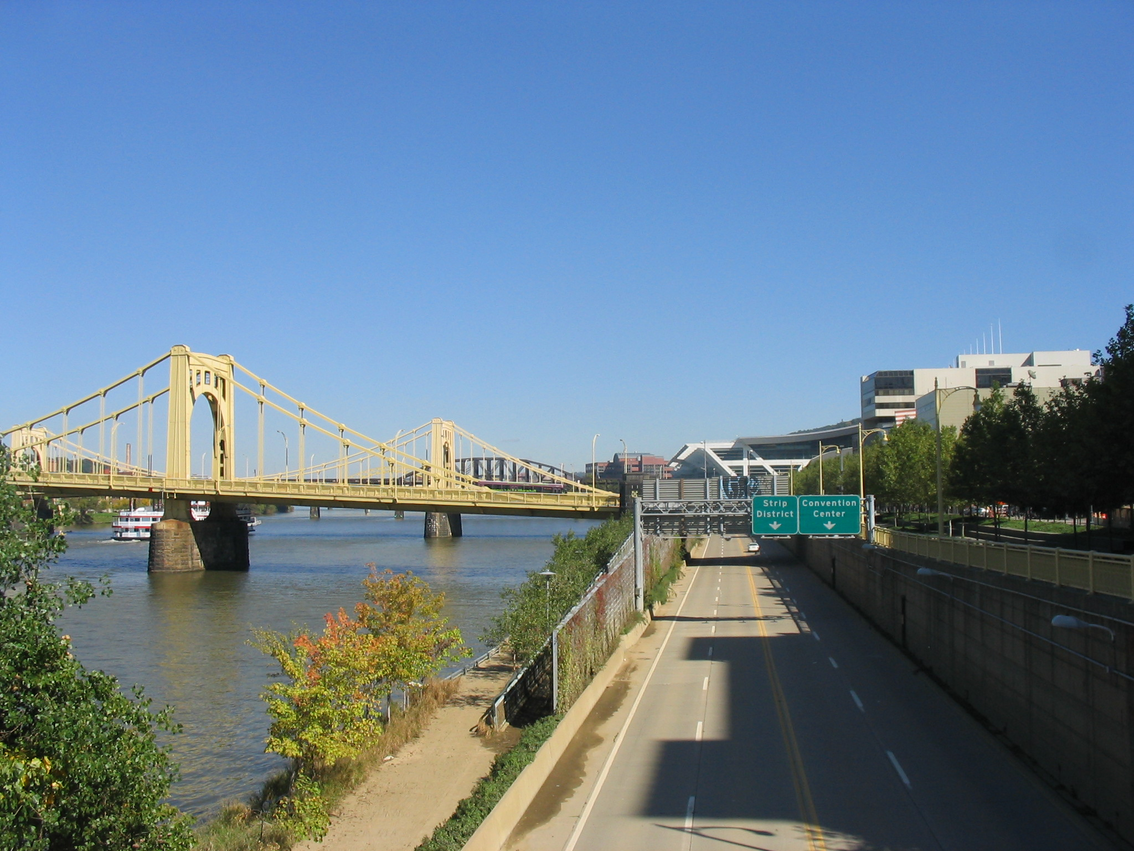
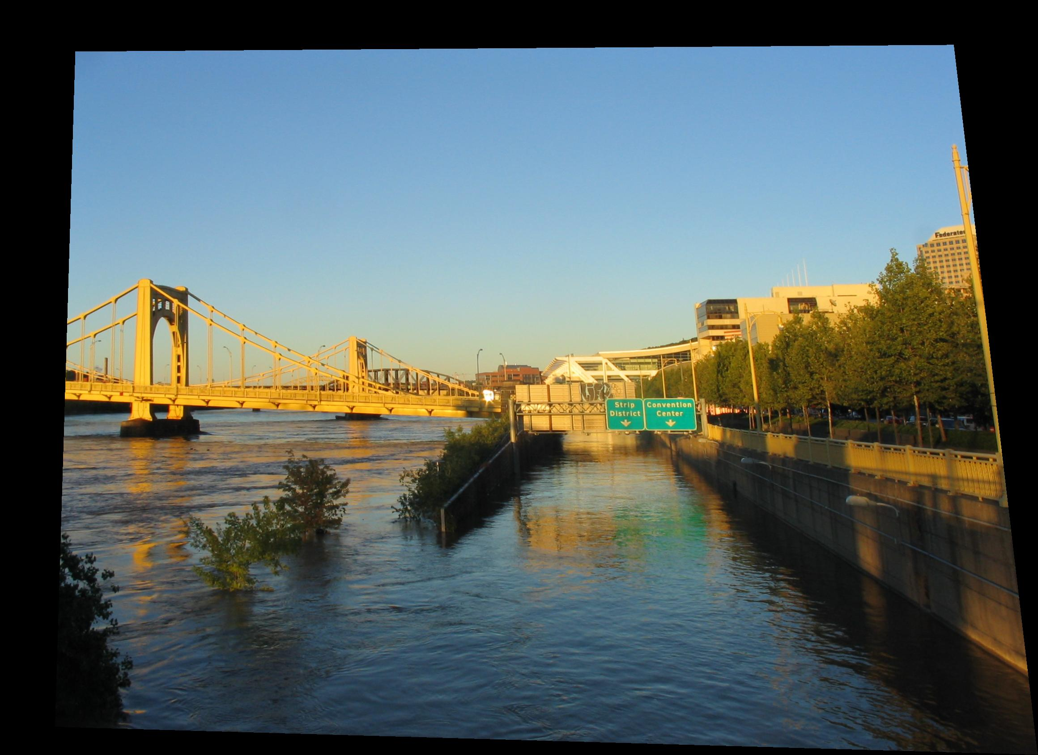
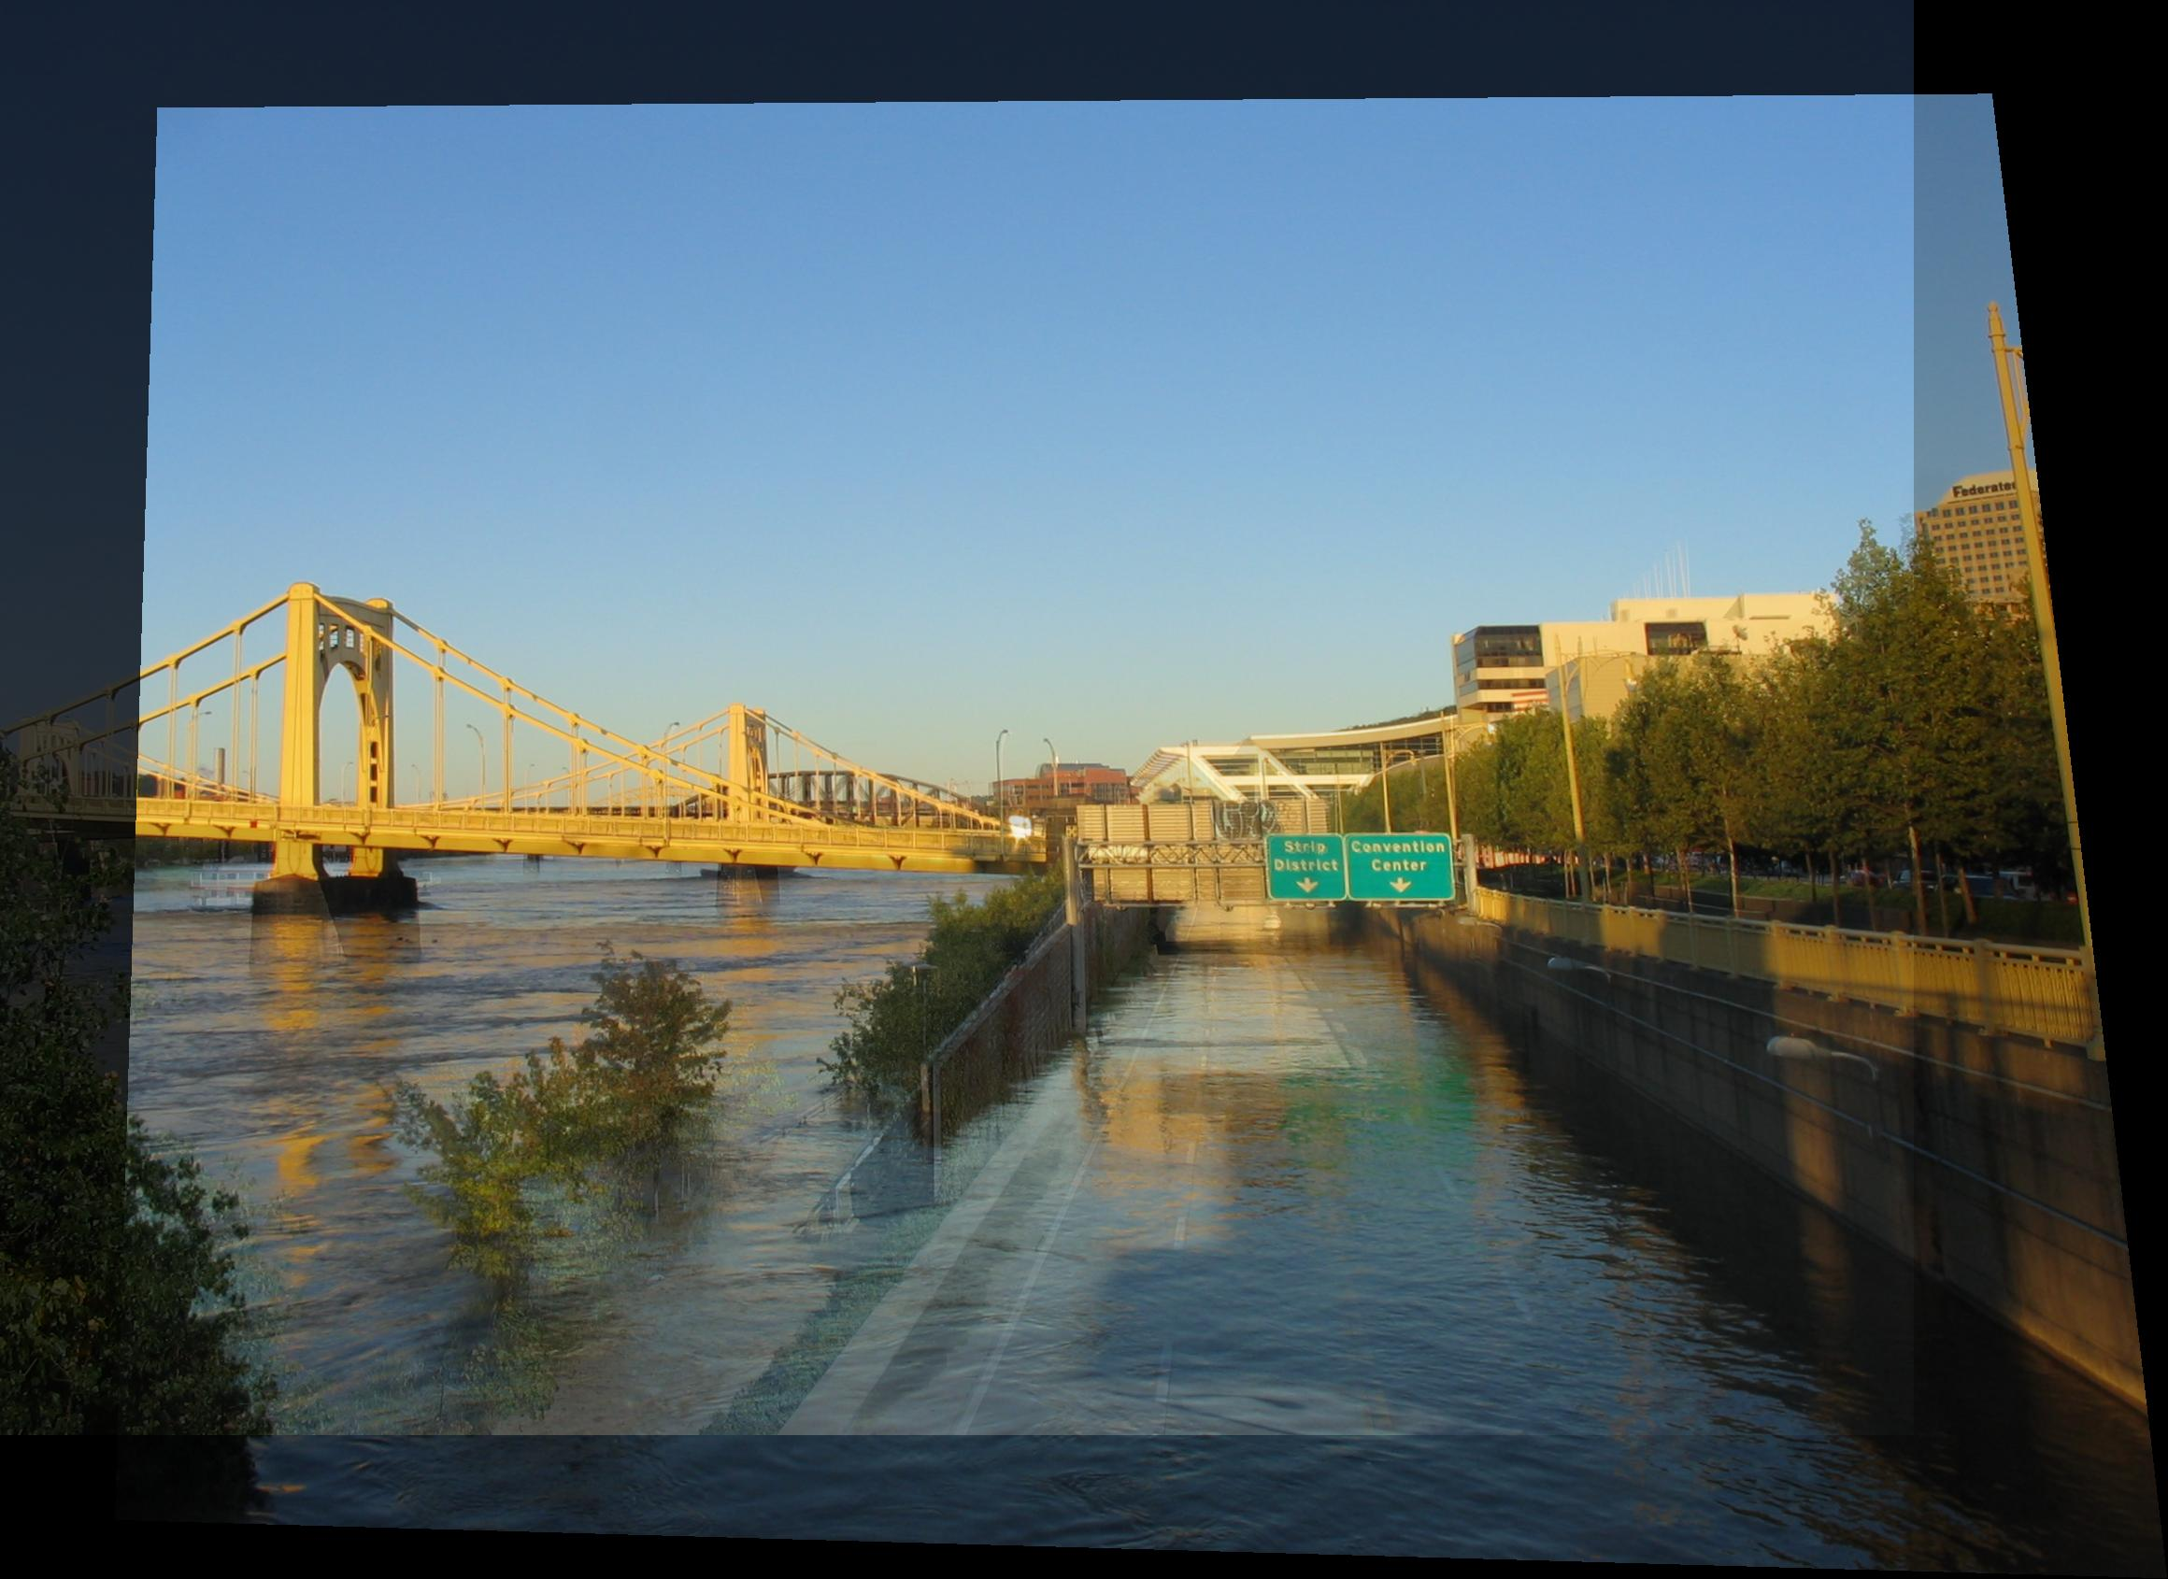
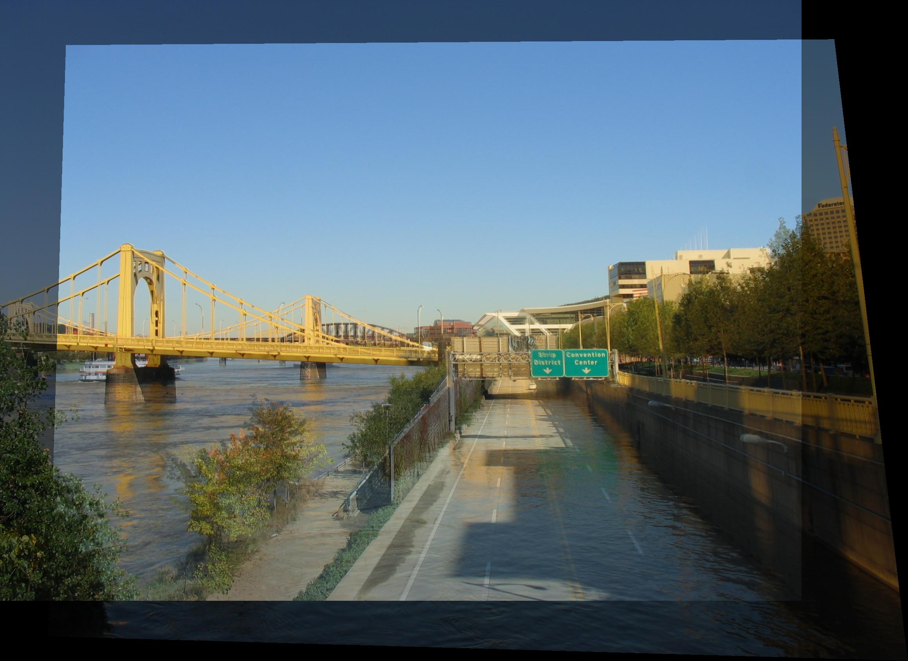
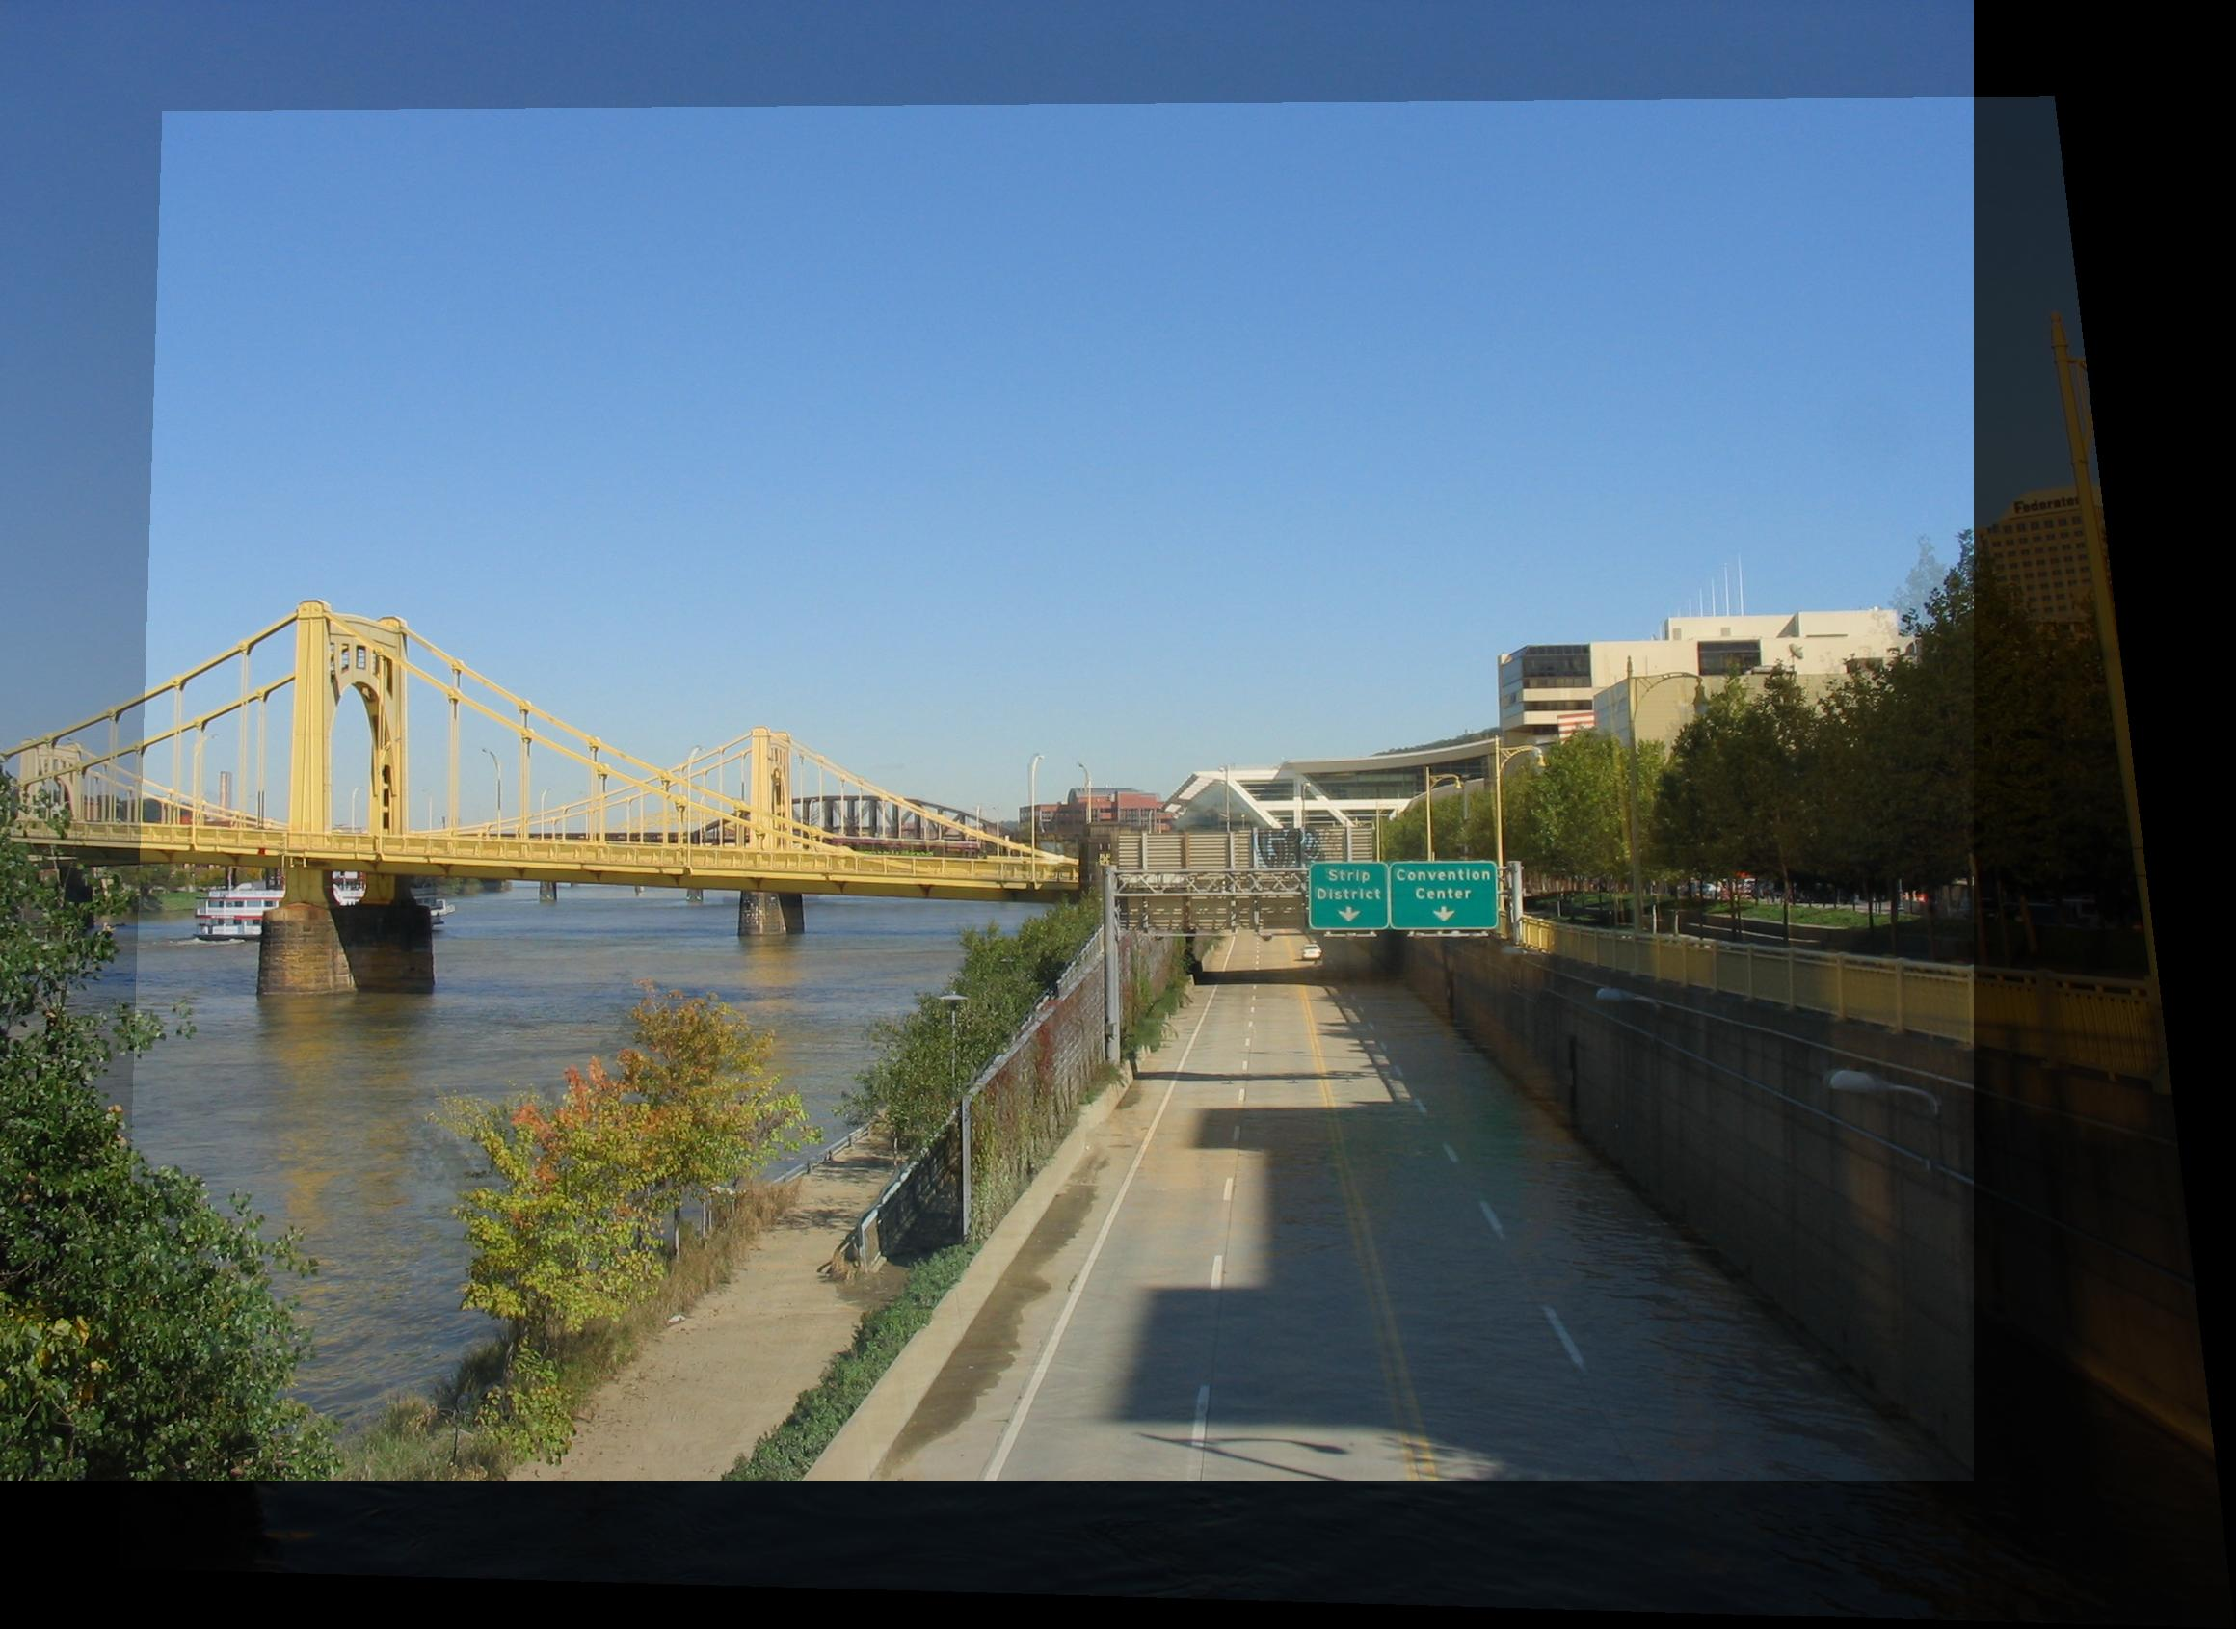
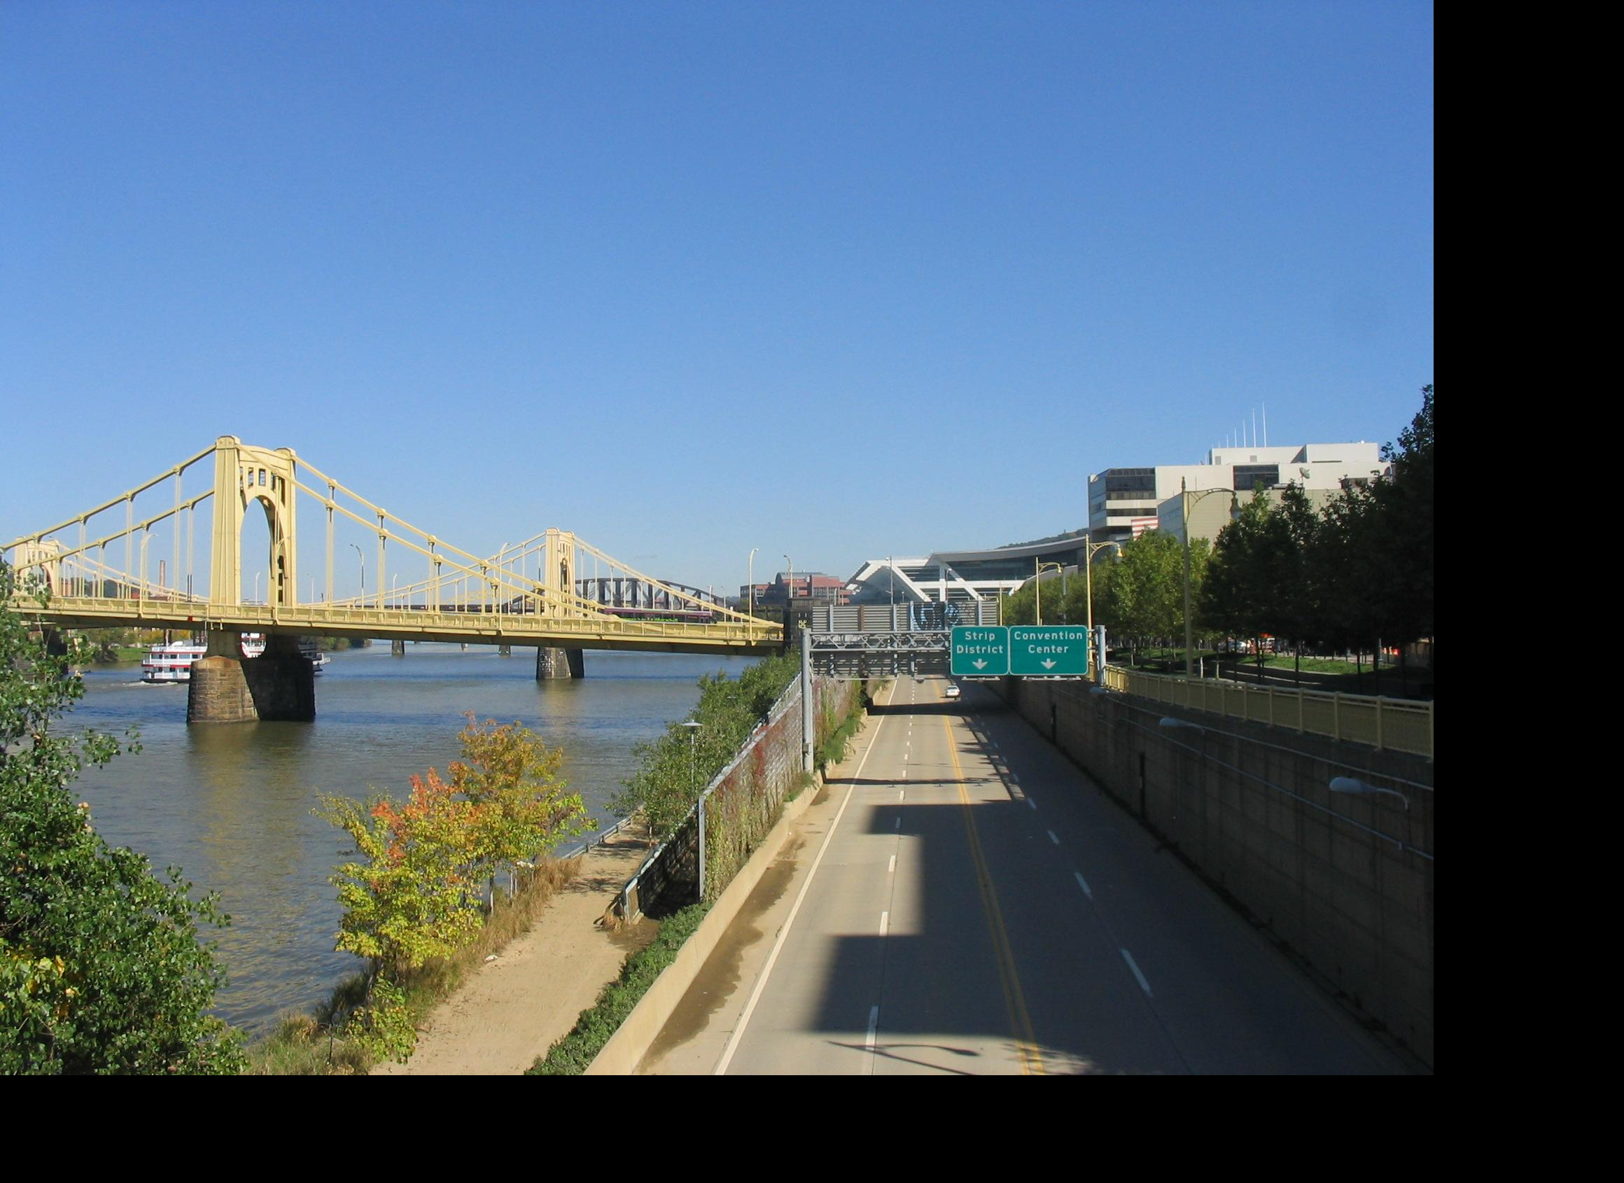
Idea #2: Align, then cross-disolve
Align first, then cross-dissolve
Alignment using global warp – picture still valid
Notes:
Ok what if we align the images first and then cross-disolve. We can compute our alignment using correspondences and finding the best global transform T then transform the right image so that it’s in the same coordinate system as the left image. Then do the cross disolve. that works better!
When won’t this work? When you can’t globally align the two images.

Slide 8
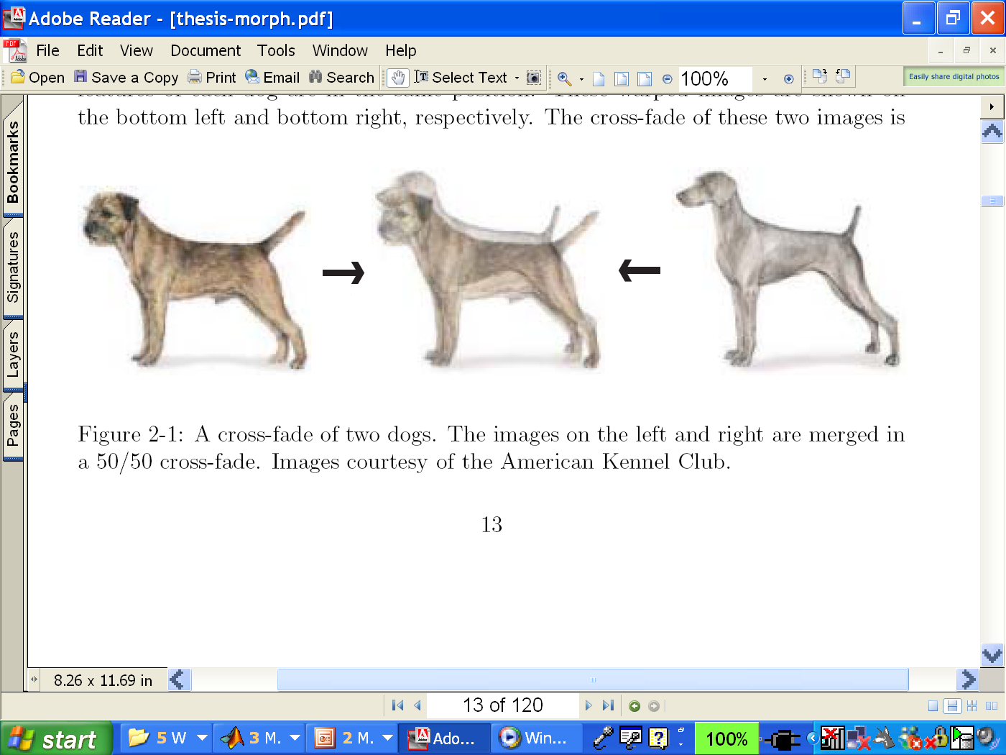
Dog Averaging
What to do?
Cross-dissolve doesn’t work
Global alignment doesn’t work
Cannot be done with a global transformation (e.g. affine)
Any ideas?
Feature matching!
Nose to nose, tail to tail, etc.
This is a local (non-parametric) warp
Notes:
But if they’re different objects you can’t just cross disolve between. And, you also can’t globally align them with one of the transformations we talked about earlier, because there is no single global transformation to go between one dog and the other.
Instead maybe we can warp each part of the dog differently if we know the correspondences between some feature points. So warm nose parts and warp tail parts and warp leg parts etc. this is a local warp.

Slide 9
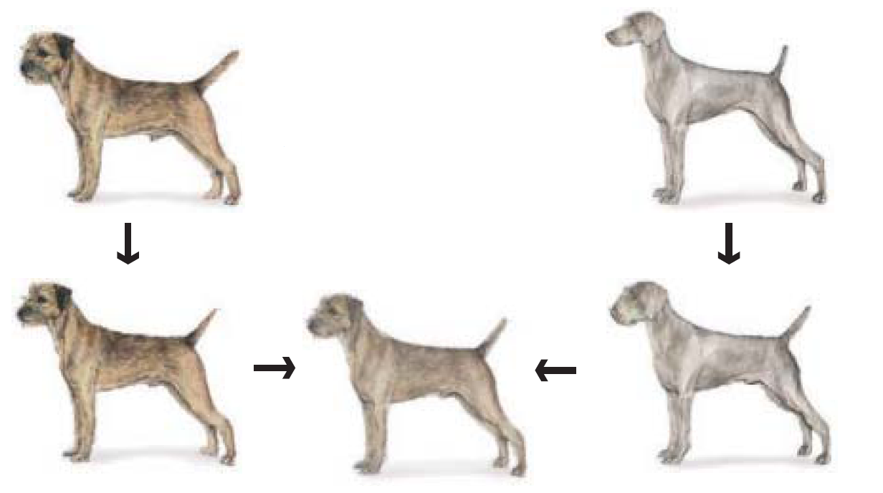
Idea #3: Local warp, then cross-dissolve
Morphing procedure:
for every t,
Find the average shape (the “mean dog”☺)
local warping
Find the average color
Cross-dissolve the warped images
Notes:
Want to warp dog top left with dog top right.
So we first find the average shape and locally warp each dog to that (bottom left, bottom right) then cross disolve the warped images to warp between one image and other.

Slide 10
Local (non-parametric) Image Warping
Need to specify a more detailed warp function
Global warps were functions of a few (2,4,8) parameters
Non-parametric warps u(x,y) and v(x,y) can be defined independently for every single location x,y!
Once we know vector field u,v we can easily warp each pixel
Notes:
So how do we do this? We need to specify a more detailed warp function. It won’t act globally across the image, but will work differently on different parts of the dog. In the limit we could have a different warp applied to each pixel!

Slide 11
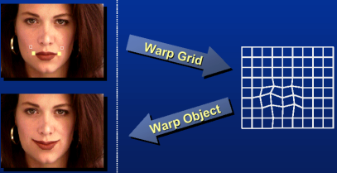
Image Warping – non-parametric
Move control points to specify a spline warp
Spline produces a smooth vector field
Notes:
One way to do this is to define a grid over the object and then specify how to warp or move each grid point. These are called control points and allows you to specify a local warping.

Slide 12
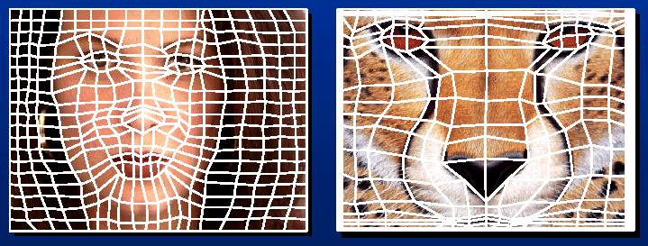
Warp specification - dense
How can we specify the warp?
Specify corresponding spline control points
interpolate to a complete warping function
But we want to specify only a few points, not a grid
Notes:
If we specify the correspondences between every control points (grid points from face to grid points on cat). Then we can interpolate between grid points on the face to grid points on the cat. But we’d rather not have to specify every correspondence between the two images.

Slide 13
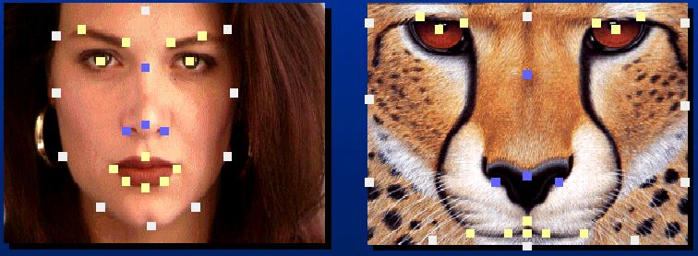
Warp specification - sparse
How can we specify the warp?
Specify corresponding points
interpolate to a complete warping function
How do we do it?
How do we go from feature points to pixels?
Notes:
Insteaad we’d like to specify a few important feature correspondences such as the eyes on the woman correspond to the eyes on the cat, nose, mouth etc. then have the algorithm make the warp based on these points, sort of dragging the in between locations along with it

Slide 14
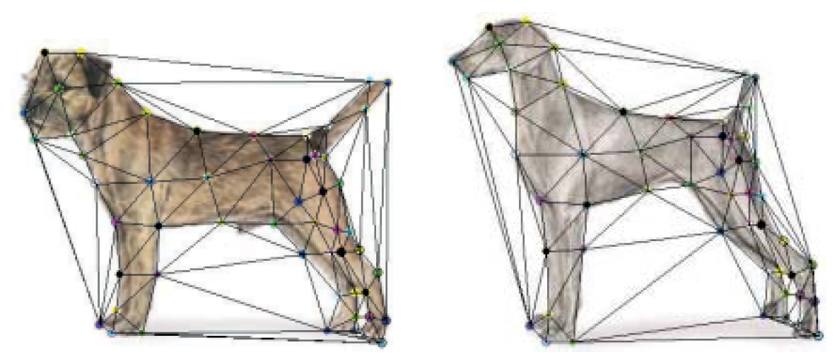
Triangular Mesh
Input correspondences at key feature points
Define a triangular mesh over the points
Same mesh in both images!
Now we have triangle-to-triangle correspondences
Notes:
Here the user would input correspondences between a small set of key feature points.
Then we can define a triangular mesh over the points, now we have triangle to triangle correspondences (since we know the correspondences between all the triangle vertices).
How do we define a this mesh?

Slide 15
Triangulations
A triangulation of set of points in the plane is a partition of the convex hull to triangles whose vertices are the points, and do not contain other points.
There are an exponential number of triangulations of a point set.

Slide 16
An O(n³) Triangulation Algorithm
Repeat until impossible:
Select two sites.
If the edge connecting them does not intersect previous edges, keep it.

Slide 17
“Quality” Triangulations
Let α(T_{i}) = (α_{i1}, α_{i2} ,.., α_{i3}) be the vector of angles in the triangulation T in increasing order:
A triangulation T₁ is “better” than T₂ if the smallest angle of T₁ is larger than the smallest angle of T₂
Delaunay triangulation is the “best” (maximizes the smallest angles)
good
bad
Notes:
Want big angles as much as possible (more stable). So left triangulation is better than right triangulation.

Slide 18
Improving a Triangulation
In any convex quadrangle, an edge flip is possible. If this flip improves the triangulation locally, it also improves the global triangulation.
If an edge flip improves the triangulation, the first edge is called “illegal”.
Notes:
To improve triangulations we can go around flipping edges. If a flip improves the triangulation locally it also improves the global triangulation.

Slide 19
Illegal Edges
Lemma: An edge pq is illegal iff one of its opposite vertices is inside the circle defined by the other three vertices.
Proof: By Thales’ theorem.
p
q
Theorem: A Delaunay triangulation does not contain illegal edges.
Corollary: A triangle is Delaunay iff the circle through its vertices is empty of other sites.
Corollary: The Delaunay triangulation is not unique if more than three sites are co-circular.

Slide 20
Naïve Delaunay Algorithm
Start with an arbitrary triangulation. Flip any illegal edge until no more exist.
Could take a long time to terminate.

Slide 21
Delaunay Triangulation by Duality
Draw the dual to the Voronoi diagram by connecting each two neighboring sites in the Voronoi diagram.
The DT may be constructed in O(nlogn) time
This is what Matlab’s delaunay function uses

Slide 22
Triangular Mesh
Input correspondences at key feature points
Define a triangular mesh over the points
Same mesh in both images!
Now we have triangle-to-triangle correspondences
Warp each triangle separately from source to destination
How do we warp a triangle?
3 points = affine warp!
Notes:
So how could you warp from left dog to right dog?
We can then use those regular transformations on each triangle separately to get the warp from one dog to the other. We know how to warp between two triangles right? That’s just an affine warp.

Slide 23
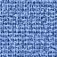
Example: warping triangles
B
B’
?
T(x,y)
C’
A
C
A’
Source
Destination
Given two triangles: ABC and A’B’C’ in 2D (12 numbers)
Need to find transform T to transfer all pixels from one to the other.
How can we compute the transformation matrix:
Notes:
So say we have two triangles that we know are in correspondence and we want to recover the affine transform T that maps between triangle ABC and A’B’C’.
How can we recover the transformation matrix for T?
well we know this (bottom eqn). This gives us two equations x’ = ax + by +c, y’ = dx+ey+f. From our triangles we have 3 points in correspondence so this gives us a system of 6 equation with 6 unknowns and we can use techniques to solve for the 6 unknowns. (x1’ = ax1+by1+c, y1’=dx1+ey1+f. x2’=ax2+by2, etc).

Slide 24
Image Morphing
We know how to warp one image into the other, but how do we create a morphing sequence?
Create an intermediate shape (by interpolation)
Warp both images towards it
Cross-dissolve the colors in the newly warped images
Notes:
So we now know how to warp between two images. How? construct the triangulation for each point set and warp between the two triangulations.
But how do we create a morphing sequence? Create an average shape, warp both images towards it (bottom row). Cross-disolve the colors in the newly warped images (right).

Slide 25
Warp interpolation
How do we create an intermediate warp at time t?
Assume t = [0,1]
Simple linear interpolation of each feature pair
(1-t)*p1+t*p0 for corresponding features p0 and p1
Notes:
So then a morph sequence is just doing this at a bunch of time steps, taking a linear combination of the corresponding features at each step. so at time 0 we take left shape, at time 1 we take right shape and in between we interpolate between the left-right locations. So at time t=0 we have points in the left dog locations and appearance is based on left dog. At time t=1 we have points in right dog locations and appearance is based on right dog.
What about time t=0.5? Where are points? Half way between location on left and location on right. We warp triangles from each dog to those locations. Now we take weighted average of appearances (in this case 50/50 for other t’s based on how far along we are in t)
.

Slide 26
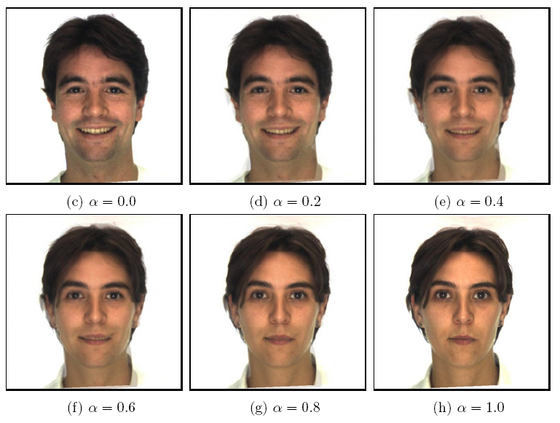
Morphing & matting
Extract foreground first to avoid artifacts in the background
Slide by Durand and Freeman
Notes:
Extensions – extract foreground first to avoid artifacts. How? Perhaps graph cuts segmentation.

Slide 27
Summary of morphing
Define corresponding points
Define triangulation on points
Use same triangulation for both images
For each t = 0:step:1
Compute the average shape (weighted average of points)
For each triangle in the average shape
Get the affine projection to the corresponding triangles in each image
For each pixel in the triangle, find the corresponding points in each image and set value to weighted average
Save the image as the next frame of the sequence

Slide 28
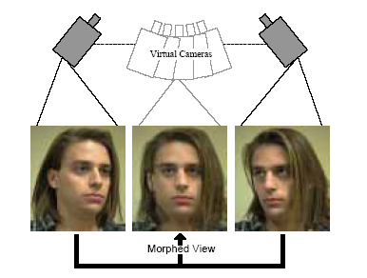
View Morphing
Steven M. Seitz, Charles R. Dyer
Notes:
What was wrong with previous morphing that this paper proposed to attack?
techniques combine 2D interpolations of shape and color to create dramatic special effects. morphing methods do not account for changes in viewpoint or object pose. As a result, simple 3D transformations (e.g., translations, rotations) become surprisingly difficult to convey convincingly using existing methods.
When morphing between different views of an object or scene, the technique produces new views of the same scene, ensuring a realistic image transition. The effect can be described by what you would see if you physically moved the object (or the camera) between its configurations in the two images and filmed the transition

Slide 29
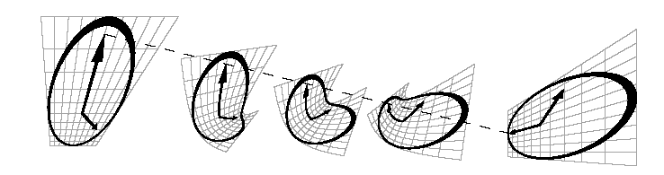
View Morphing: Key Idea
Beier-Neely morph is NOT shape-preserving!
distortions
un-natural
A Shape-Distorting Morph
Source: Steven M. Seitz, Charles R. Dyer
Slide credit: Irwin Chiu Hau
Notes:
Linearly interpolating two perspective views of a clock (far left and far right) causes a geometric bending effect in the in-between images. The dashed line shows the linear path of one feature during the course of the transformation.
Ghosting can also occur as we saw before when doing blending (here we do blending as well for the intermediate pics)

Slide 30
View Morphing: Key Idea
View morphing uses 3D shape preserving morph!
no distortions
natural
A morph is 3D shape preserving if the results of two
different views represent new views of the same object
View morphing fixes
these intermediate
steps!
A Shape-Distorting Morph
Source: Steven M. Seitz, Charles R. Dyer
Slide credit: Irwin Chiu Hau
Notes:
an interpolation based image morphing procedure that is shape-preserving. Morphs generated by this technique create the illusion that the object moves
rigidly (rotating and translating in 3D) between its positions in the two images.

Slide 31
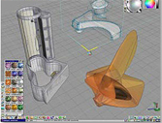
Why do we care?
View morphing is efficient
Produces new views without
3D modeling
Taking additional photos
View morphing creates impressive effects
Camera motion
Image morphing
trueSpace
Source: www.caligari.com
Slide credit: Irwin Chiu Hau

Slide 32
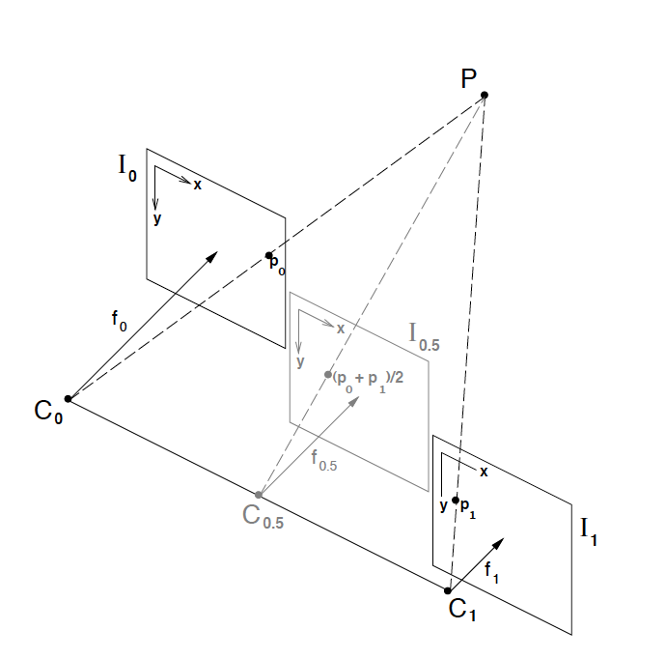
Consider parallel views
Notes:
Linear interpolation of corresponding pixels in parallel views with image planes I0 and I1 creates image I0:5, representing another parallel view of the same scene.
So, that’s good! A morph here creates a new view of the same object. So how do we use this fact?

Slide 33
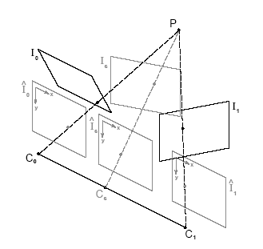
How to do View Morphing?
View morphing in three steps
Prewarp two images
Compute a morph between the prewarped images
Postwarp each in between images produced by the morph
Slide credit: Irwin Chiu Hau
Notes:
If we have non-parallel views what should we do? We can reproject – warp the images to parallel views first then morph as usual then warp this to form the final result.
View Morphing in Three Steps. (1) Original images I_0 and I_1 are pre-warped to form parallel views I^0 and I^1. (2) I^s is produced by morphing (interpolating as usual) the prewarped images I^0 and I^1. (3) I^s is postwarped to form I_s.
Prewarping brings the image planes into alignment without changing the optical centers of the two cameras. Morphing the prewarped images moves the optical center to Cs. Postwarping transforms the image plane of the new view to its desired position and orientation.
To get the whole sequence requires choosing a sequence of projection matrices beginning with the matrix for I0 and ending at I1

Slide 34
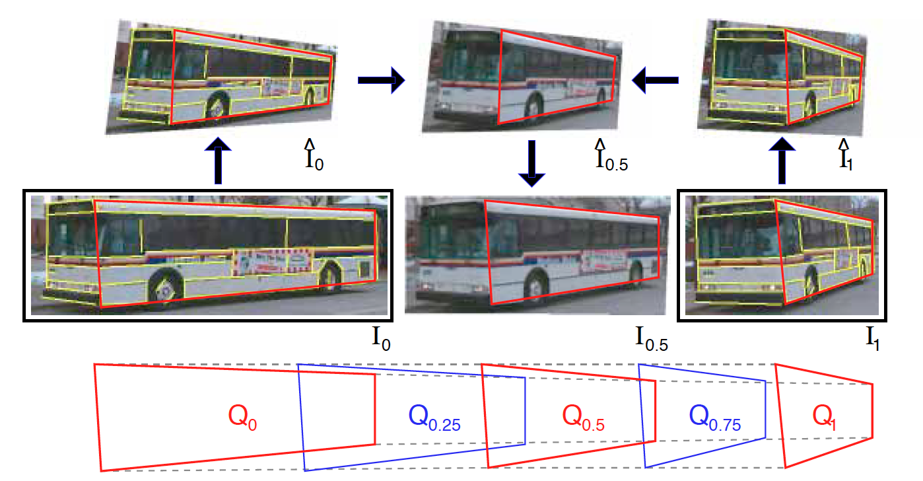
Results
Notes:
Middle row: A set of features (yellow lines, ie correspondences) is selected in original images I0 and I1.
Using these features, the images are automatically warped to produce ^I0 and ^I1.
The prewarped images are morphed to create a sequence of in-between images, the middle of which, ^I0:5, is shown at top-center.
^I0:5 is interactively postwarped by selecting a quadrilateral region (marked red) and specifying its desired configuration, Q0.5 (this gives us intermediate view I0.5). The postwarps for other in-between images are determined by interpolating the quadrilaterals (bottom) to get other intermediate views.
-

Slide 35
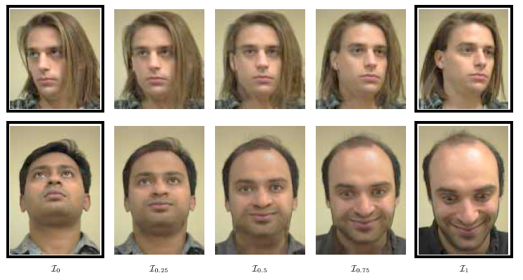
Results
Facial view morphs
Source: Steven M. Seitz, Charles R. Dyer
Slide credit: Irwin Chiu Hau
Notes:
By generalizing what we mean by a “view”, the technique described in the previous section can be extended to accommodate a range of 3D shape deformations.

Slide 36
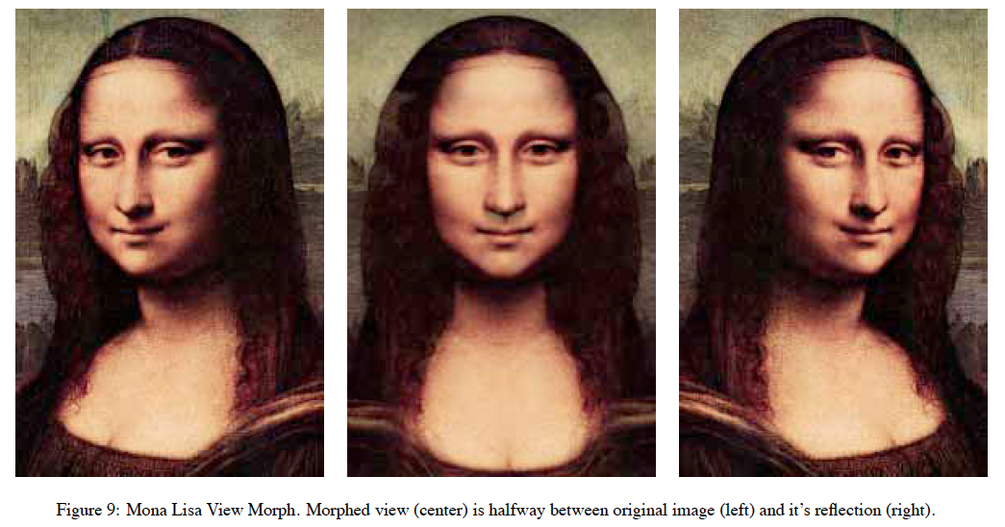
Results

Slide 37
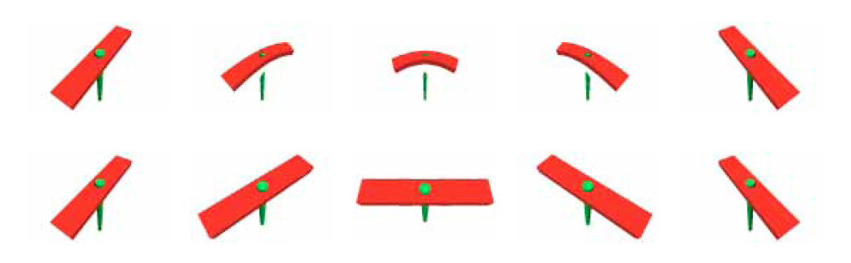
Results
Top: Image Morph
Bottom: View Morph

Slide 38
Have a good spring break!

